Slide 1
Anderson Localization in presence of spin-orbit coupling in an atomic Bose gas
Yuchen Yue, Emine Altuntas, Francisco Salces-Carcoba, Andika Putra, Chris Billington, Ian B. Spielman
Joint Quantum Institute, NIST

Slide 2
Outline of the talk
Introduction to Anderson Localization(AL).
Exprimental realization of AL with cold atoms.
AL in presence of spin-orbit coupling.
Numerical simulation results.
Experimental design.

Slide 3
Outline of the talk
Introduction to Anderson Localization(AL).
Exprimental realization of AL with cold atoms.
AL in presence of spin-orbit coupling.
Numerical simulation results.
Experimental design.

Slide 4
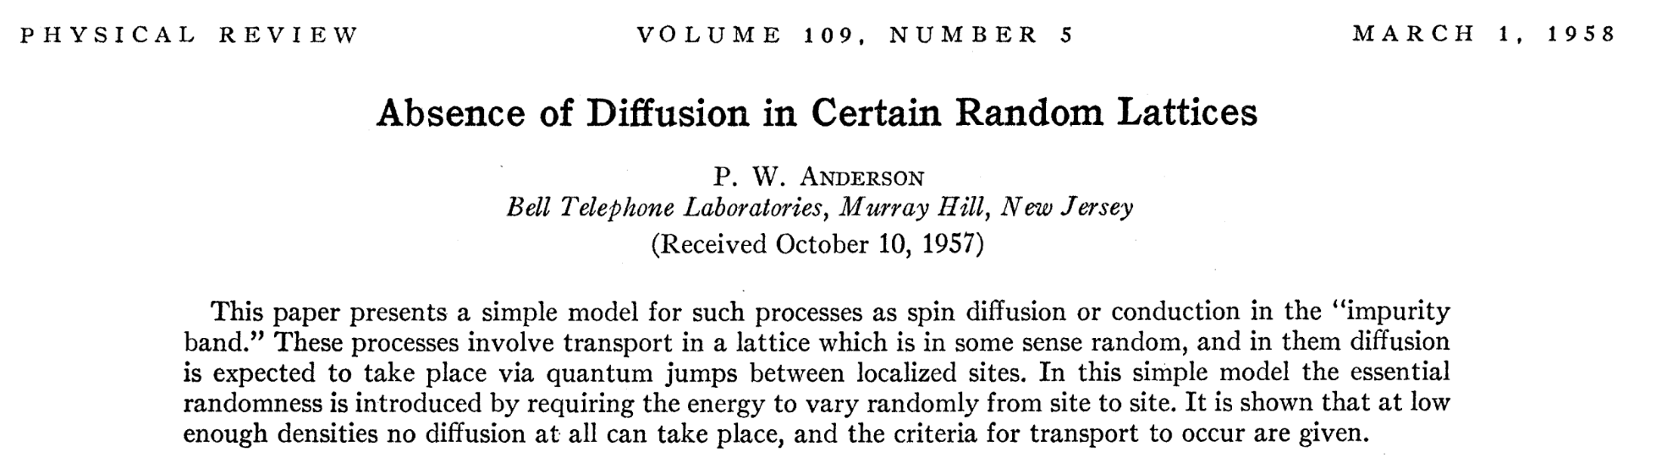
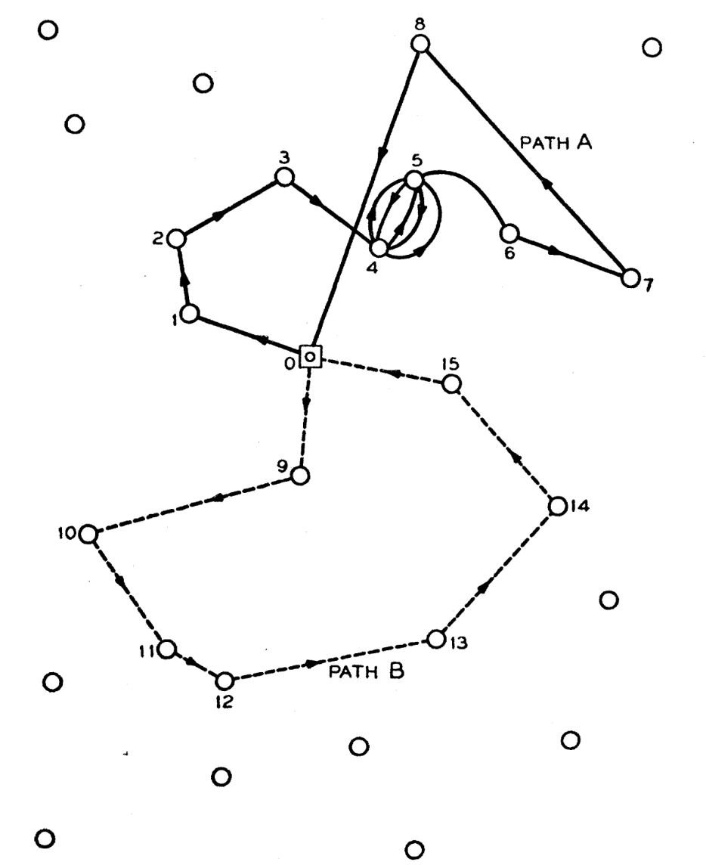
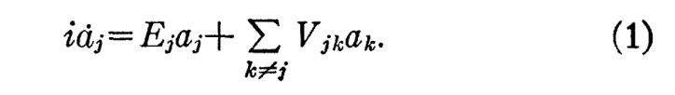
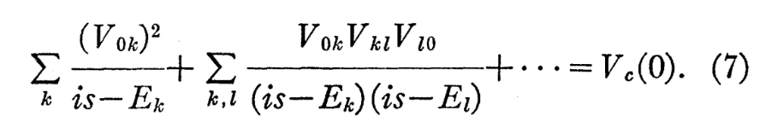
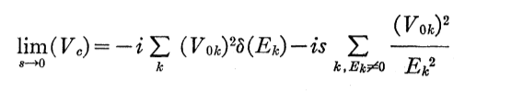

Introduction to AL

Slide 5
Outline of the talk
Introduction to Anderson Localization(AL).
Exprimental realization of AL with cold atoms.
AL in presence of spin-orbit coupling.
Numerical simulation results.
Experimental design.

Slide 6
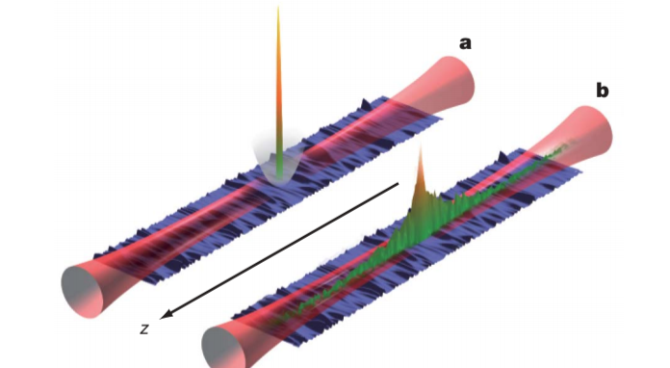
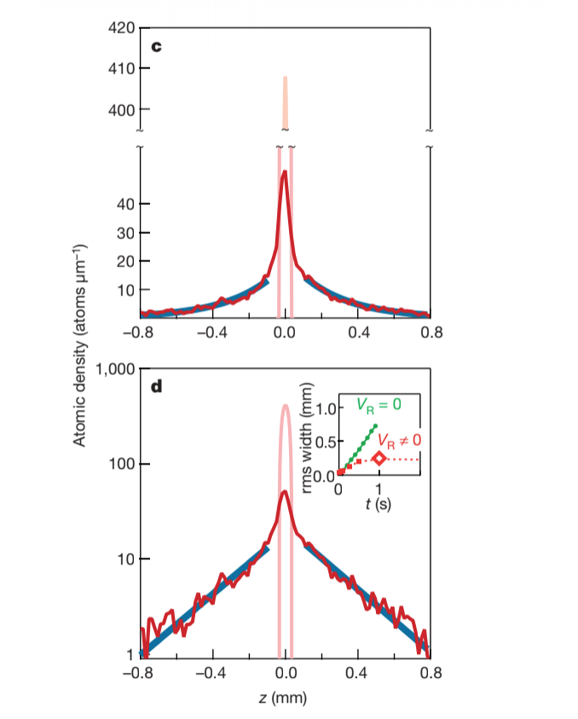
Exprimental realization of AL with cold atoms.

Slide 7
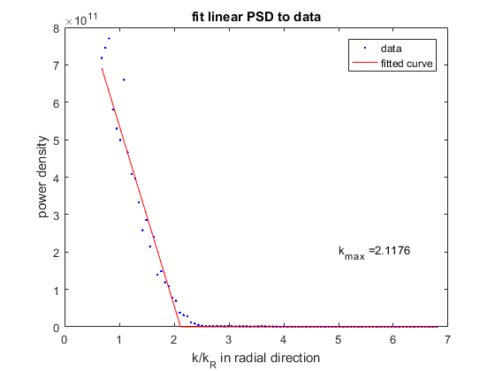
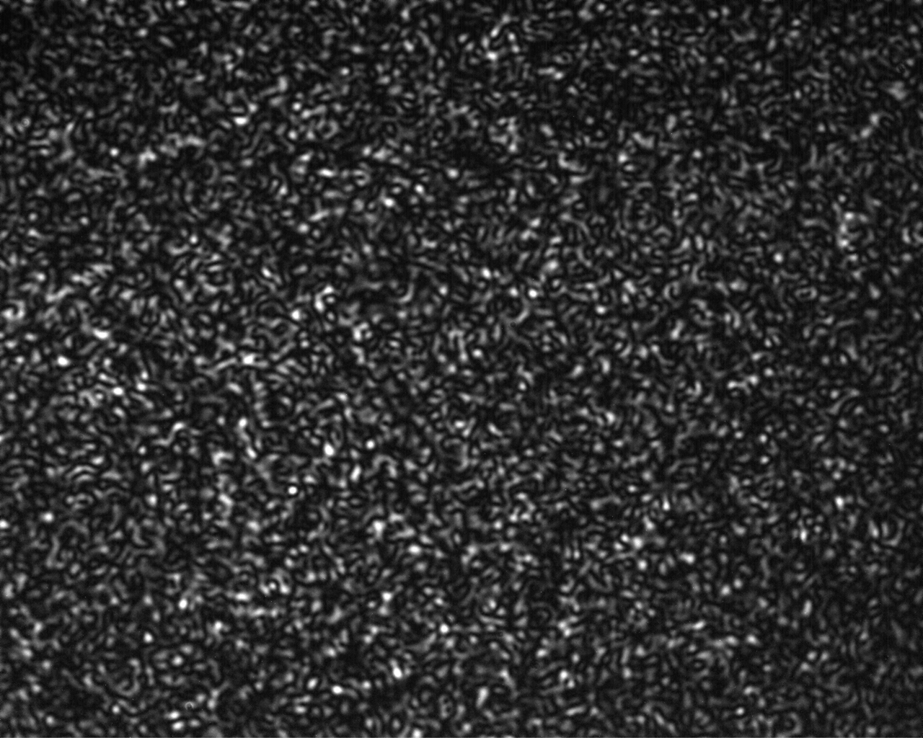
Laser speckle and AL in k space
Laser field acquire random phase by reflection off rough surface or transmission of rough media.

Slide 8
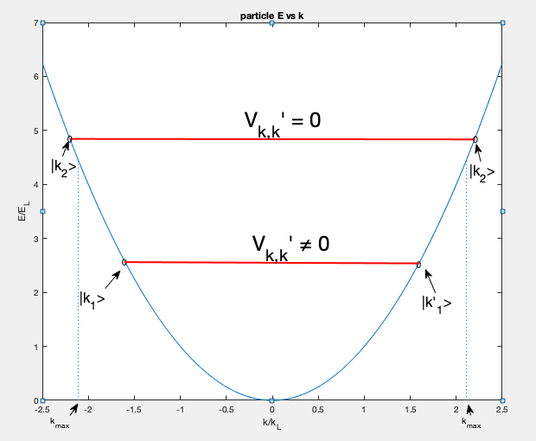
Laser speckle and AL in k space

Slide 9
Outline of the talk
Introduction to Anderson Localization(AL).
Exprimental realization of AL with cold atoms.
AL in presence of spin-orbit coupling.
Numerical simulation results.
Experimental design.

Slide 10
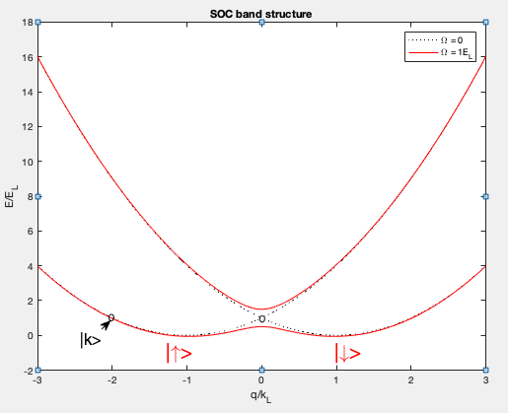
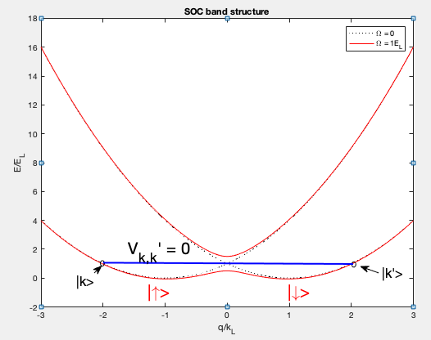
AL in presence of spin-orbit coupling.

